Slide 1
Unit II
The Representation of Knowledge

Slide 2
Logic and Inferences

Slide 3
Formal Logic
Formal Logic is the science of deductive reasoning
Definition: “reasoning from known premises, or premises presumed to be true, to a certain conclusion.”
In contrast, most everyday arguments involve inductive reasoning.
reasoning from uncertain premises to probabilistic conclusions
“inference-making”
Formal logic cannot establish the truth of the premises. The truth of the premises must be presumed, or taken as a given.
Some premises may be proven or authenticated by scientific testing, reference to external sources, etc.
Some premises may be granted or stipulated by all the parties to an argument
Some premises may have been established as the conclusion of a previous argument

Slide 4
In deduction, proofs are always valid or invalid.
The form or structure of a deductive argument determines its validity
The fundamental property of a valid, deductive argument is that IF the premises are true, THEN the conclusion necessarily follows.
The conclusion is said to be “entailed” in, or contained in, the premises.
If all pigs have curly tails
And Nadine is a pig
Then Nadine has a curly tail

Slide 5
Entailment
Given collection of true statements (premises), one is interested in knowing what other statements are logically Entailed (necessarily made true)
way to prove entailment between two sentences is to demonstrate that if the one sentence is false, then the other sentence must also be false. Entailment is closely related to the concept of logical consequence. Within logic, the idea that if A is true, then B must be true too is nothing other than a form of entailment.

Slide 6
Proof
Soundness
Produces only true statements
Completeness
Produces all true statements
Consistency
Does not produce both a sentence and its negation

Slide 7
Well formed Formula
Language is used to express statements in the logic
Wff- sentence in logic
Propositional logic – sound, complete and decidable systems
FOL – Loss decidability

Slide 8
Propositional logic
Logical constants: true, false
Propositional symbols: P, Q, S, ... (atomic sentences)
Wrapping parentheses: ( … )
Sentences are combined by connectives:
∧ ...and [conjunction]
∨ ...or [disjunction]
⇒...implies [implication / conditional]
⇔..is equivalent [biconditional]
¬ ...not [negation]
Literal: atomic sentence or negated atomic sentence

Slide 9
Examples of PL sentences
P means “It is hot.”
Q means “It is humid.”
R means “It is raining.”
(P ∧ Q) → R
“If it is hot and humid, then it is raining”
Q → P
“If it is humid, then it is hot”
A better way:
Hot = “It is hot”
Humid = “It is humid”
Raining = “It is raining”

Slide 10
Why Propositional Logic used in AI
Propositional logic is used in artificial intelligence for planning, problem-solving, intelligent control and most importantly for decision-making. It is all about Boolean functions and the statements where there are more than just true and false values, includes the certainty as well as uncertainty, it led to the foundation for machine learning models. It is a useful tool for reasoning, but it has limitation because it cannot see inside prepositions and take advantage of relationships among them.

Slide 11
Propositional logic (PL)
A simple language useful for showing key ideas and definitions
User defines a set of propositional symbols, like P and Q.
User defines the semantics of each propositional symbol:
P means “It is hot”
Q means “It is humid”
R means “It is raining”
A sentence (well formed formula) is defined as follows:
A symbol is a sentence
If S is a sentence, then ¬S is a sentence
If S is a sentence, then (S) is a sentence
If S and T are sentences, then (S ∨ T), (S ∧ T), (S → T), and (S ↔ T) are sentences
A sentence results from a finite number of applications of the above rules

Slide 12
Some terms
The meaning or semantics of a sentence determines its interpretation.
Given the truth values of all symbols in a sentence, it can be “evaluated” to determine its truth value (True or False).
A model for a KB is a “possible world” (assignment of truth values to propositional symbols) in which each sentence in the KB is True.

Slide 13
More terms
A valid sentence or tautology is a sentence that is True under all interpretations, no matter what the world is actually like or how the semantics are defined. Example: “It’s raining or it’s not raining.”
An inconsistent sentence or contradiction is a sentence that is False under all interpretations. The world is never like what it describes, as in “It’s raining and it’s not raining.”
P entails Q, written P |= Q, means that whenever P is True, so is Q. In other words, all models of P are also models of Q.

Slide 14
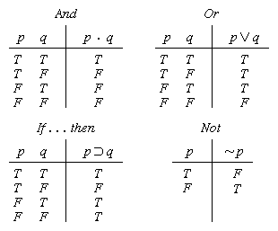
Truth tables

Slide 15


Truth tables II
The five logical connectives:
A complex sentence:

Slide 16
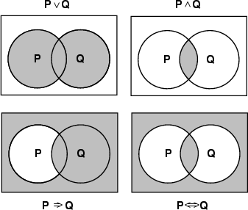
Models of complex sentences

Slide 17
Inference rules
Logical inference is used to create new sentences that logically follow from a given set of predicate calculus sentences (KB).
An inference rule is sound if every sentence X produced by an inference rule operating on a KB logically follows from the KB. (That is, the inference rule does not create any contradictions)
An inference rule is complete if it is able to produce every expression that logically follows from (is entailed by) the KB. (Note the analogy to complete search algorithms.)

Slide 18
Sound rules of inference
Here are some examples of sound rules of inference
A rule is sound if its conclusion is true whenever the premise is true
Each can be shown to be sound using a truth table
RULE PREMISE CONCLUSION
Modus Ponens A, A → B B
And Introduction A, B A ∧ B
And Elimination A ∧ B A
Double Negation ¬¬A A
Unit Resolution A ∨ B, ¬B A
Resolution A ∨ B, ¬B ∨ C A ∨ C

Slide 19
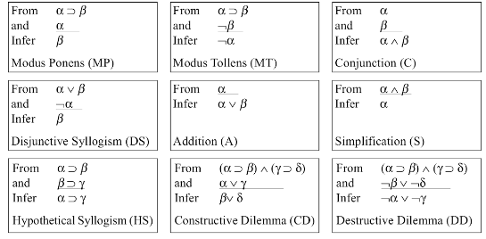

Slide 20
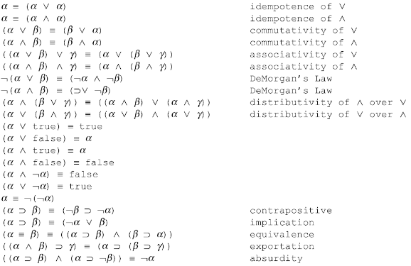

Slide 21
Resolution
Resolution is a valid inference rule producing a new clause implied by two clauses containing complementary literals
A literal is an atomic symbol or its negation, i.e., P, ~P
Amazingly, this is the only interference rule you need to build a sound and complete theorem prover
Based on proof by contradiction and usually called resolution refutation

Slide 22
Resolution
A KB is actually a set of sentences all of which are true, i.e., a conjunction of sentences.
To use resolution, put KB into conjunctive normal form (CNF), where each sentence written as a disjunction of (one or more) literals
Example
KB: [P→Q , Q→R∧S]
KB in CNF: [~P∨Q , ~Q∨R , ~Q∨S]
Resolve KB(1) and KB(2) producing: ~P∨R (i.e., P→R)
Resolve KB(1) and KB(3) producing: ~P∨S (i.e., P→S)
New KB: [~P∨Q , ~Q∨~R∨~S , ~P∨R , ~P∨S]
Tautologies
(A→B)↔(~A∨B)
(A∨(B∧C)) ↔(A∨B)∧(A∨C)

Slide 23
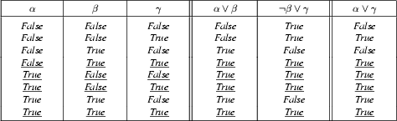
Soundness of the resolution inference rule

Slide 24
Proving things
A proof is a sequence of sentences, where each sentence is either a premise or a sentence derived from earlier sentences in the proof by one of the rules of inference.
The last sentence is the theorem (also called goal or query) that we want to prove.
Example for the “weather problem” given above.
1 Humid Premise “It is humid”
2 Humid→Hot Premise “If it is humid, it is hot”
3 Hot Modus Ponens(1,2) “It is hot”
4 (Hot∧Humid)→Rain Premise “If it’s hot & humid, it’s raining”
5 Hot∧Humid And Introduction(1,2) “It is hot and humid”
6 Rain Modus Ponens(4,5) “It is raining”

Slide 25
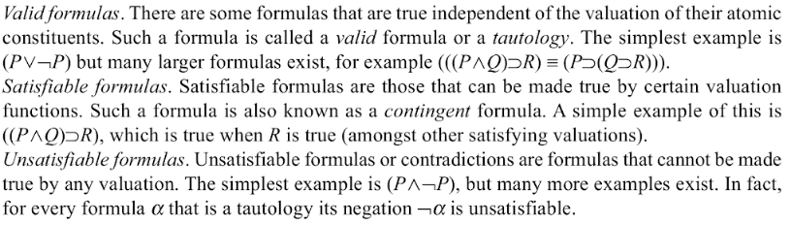

Slide 26
Two important properties for inference
Soundness: If KB |- Q then KB |= Q
If Q is derived from a set of sentences KB using a given set of rules of inference, then Q is entailed by KB.
Hence, inference produces only real entailments, or any sentence that follows deductively from the premises is valid.
Completeness: If KB |= Q then KB |- Q
If Q is entailed by a set of sentences KB, then Q can be derived from KB using the rules of inference.
Hence, inference produces all entailments, or all valid sentences can be proved from the premises.

Slide 27
Propositional logic is a weak language
Hard to identify “individuals” (e.g., Mary, 3)
Can’t directly talk about properties of individuals or relations between individuals (e.g., “Bill is tall”)
Generalizations, patterns, regularities can’t easily be represented (e.g., “all triangles have 3 sides”)
First-Order Logic (abbreviated FOL or FOPC) is expressive enough to concisely represent this kind of information
FOL adds relations, variables, and quantifiers, e.g.,
“Every elephant is gray”: ∀ x (elephant(x) → gray(x))
“There is a white alligator”: ∃ x (alligator(X) ^ white(X))

Slide 28
Example
Consider the problem of representing the following information:
Every person is mortal.
Confucius is a person.
Confucius is mortal.
How can these sentences be represented so that we can infer the third sentence from the first two?

Slide 29
Example II
In PL we have to create propositional symbols to stand for all or part of each sentence. For example, we might have:
P = “person”; Q = “mortal”; R = “Confucius”
so the above 3 sentences are represented as:
P → Q; R → P; R → Q
Although the third sentence is entailed by the first two, we needed an explicit symbol, R, to represent an individual, Confucius, who is a member of the classes “person” and “mortal”
To represent other individuals we must introduce separate symbols for each one, with some way to represent the fact that all individuals who are “people” are also “mortal”

Slide 30
Resolution (for CNF)
Very important inference rule – several other inference rules can be seen as special cases of resolution.
P ∨ Q
¬P ∨ R
∴ Q ∨ R
Soundness of rule (validity of rule):
[(P ∨ Q) ∧ (¬P ∨ R)] → (Q ∨ R) is valid
Resolution for CNF – applied to a special type of wffs: conjunction of clauses.
Literal – either an atom (e.g., P) or its negation (¬P).
Clause – disjunction of literals (e.g., (P ∨ Q ∨ ¬R)).

Slide 31
Soundness of Resolution: Validity of the Resolution Inference Rule
P ∨ Q
¬P ∨ R
∴ Q ∨ R
resolving on P
Validity (Tautology): (P ∨ Q) (¬P ∨ R) → (Q ∨ R) ;
P | Q | R | (P∨Q) | (¬P∨R) | (P∨Q)∧(¬P∨R) | (Q∨R) | (P ∨ Q) (¬P ∨ R) → (Q ∨ R)
0 | 0 | 0 | 0 | 1 | 0 | 0 | 1
0 | 0 | 1 | 0 | 1 | 0 | 1 | 1
0 | 1 | 0 | 1 | 1 | 1 | 1 | 1
1 | 0 | 0 | 1 | 0 | 0 | 0 | 1
1 | 1 | 0 | 1 | 0 | 0 | 1 | 1
1 | 0 | 1 | 1 | 1 | 1 | 1 | 1
0 | 1 | 1 | 1 | 1 | 1 | 1 | 1
0 | 0 | 0 | 0 | 1 | 0 | 0 | 1

Slide 32
Resolution: Special Cases
1 – Rule of Inference: Chaining
R ∨ P
¬P ∨ Q
∴ R ∨ Q
¬R → P
P → Q
∴ ¬R →Q
can be re-written
Rule of Inference Chaining
2 – Rule of Inference: Modus Ponens
P
¬P ∨ Q
∴ Q
P
P → Q
∴ Q
can be re-written
Rule of Inference: Modus Ponens

Slide 33
Resolution: Special Cases
3 – Unit Resolution
¬P
P ∨ Q
∴ Q
P
¬P ∨ Q
∴ Q

Slide 34
Resolution:
No duplications in the resolvent set
P ∨ Q ∨ R ∨ S
¬P ∨ Q ∨ W
∴ Q ∨ R ∨ S ∨ W
only one instance of Q
appears in the resolvent,
which is a set!

Slide 35
CNF
Conjunctive Normal Form (CNF)
A wff is in CNF format when it is a conjunction of disjunctions of literals.
(¬P ∨ Q ∨ R) ∧(S ∨ P ∨ T ∨¬R) ∧(Q ∨ S)
Resolution for CNF – applied to wffs in CNF format.

Slide 36
Conversion to CNF
P ↔ (Q ∨ R)
1.Eliminate ↔, replacing α ↔ β with (α → β)∧(β → α).
(P → (Q ∨ R)) ∧ ((Q∨ R) → P)
2. Eliminate →, replacing α → β with ¬α∨ β.
(¬P ∨ Q ∨ R) ∧ (¬(Q∨ R) ∨ P)
3. Move ¬ inwards using de Morgan's rules and double-negation:
(¬P∨ Q∨ R) ∧ ((¬Q∧ ¬R) ∨ P)
4. Apply distributivity law (∧ over ∨) and flatten:
(¬P ∨ Q ∨ R) ∧ (¬Q∨ P) ∧ (¬R ∨ P)

Slide 37
Resolution
Resolution is refutation complete (Completeness of resolution refutation):
If KB ╞ W, the resolution refutation procedure, i.e., applying resolution on KB’, will produce the empty clause.
Decidability of propositional calculus by resolution refutation:
If KB is a set of finite clauses and if KB ╞ W, then the resolution refutation procedure will terminate without producing the empty clause.
Ground Resolution Theorem
If a set of clauses is not satisfiable, then resolution closure of those clauses contains the empty clause.

Slide 38
Resolution example: Wumpus World
KB = (B_{1,1} ⇔ (P_{1,2}∨ P_{2,1})) ∧¬ B_{1,1} α = ¬P_{1,2}
KB = (B₁₁ → (P_{1,2}∨ P_{2,1})) ^ ((P_{1,2}∨ P_{2,1}) → B₁₁) ∧¬ B_{1,1}
=(¬B₁₁ ∨ P_{1,2}∨ P_{2,1}) ^ (¬(P_{1,2}∨ P_{2,1}) ∨ B₁₁) ∧¬ B_{1,1}
=(¬B₁₁ ∨ P_{1,2}∨ P_{2,1}) ^((¬ P_{1,2} ^ ¬ P_{2,1}) ∨ B₁₁)) ∧¬ B_{1,1}
=(¬B₁₁ ∨ P_{1,2}∨ P_{2,1}) ^(¬ P_{1,2} ∨ B₁₁) ^ (¬ P_{2,1} ∨ _{B11}) ∧¬ B_{1,1}

Slide 39
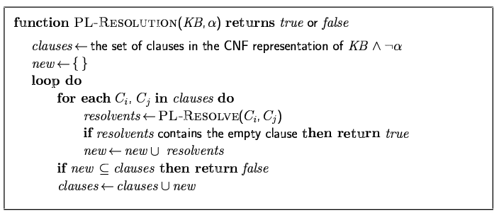
Resolution algorithm
Proof by contradiction, i.e., show KB∧¬α unsatisfiable
New resolvents added at the end

Slide 40
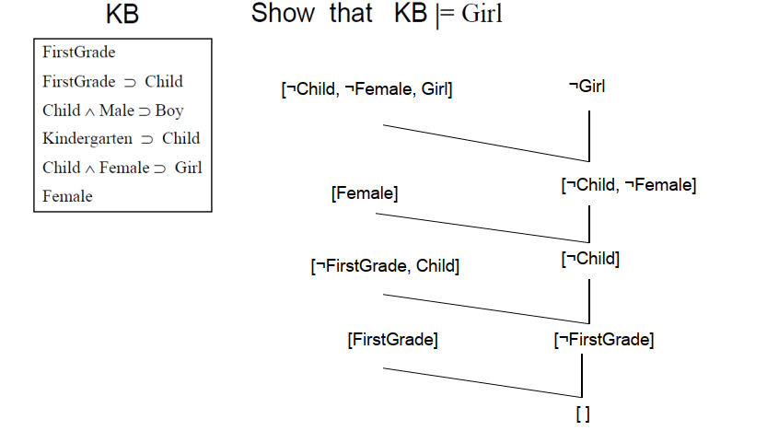
SLD

Slide 41
Resolution Refutation – Ordering Search Strategies
0th level resolvents
BatIsOk
¬RobotMoves
BatIsOk ∨ ¬BlockLiftable ∨ RobotMoves
BlockLiftable
Original clauses – 0th level resolvents
Breadth first strategy →
Generate all 1st level resolvents, then all 2nd level resolvents, etc.
Depth first strategy →
Produce a 1st level resolvent;
Resolve the 1st level resolvent with a 0th level resolvent to produce a 2nd level resolvent, etc.
With a depth bound, we can use a backtrack search strategy;
BlockLiftable
BatIsOk ∨ ¬BlockLiftable ∨ RobotMoves
¬RobotMoves
BatIsOk ∨ RobotMoves
¬BatIsOk
BatIsOk
Nil
Depth first strategy

Slide 42
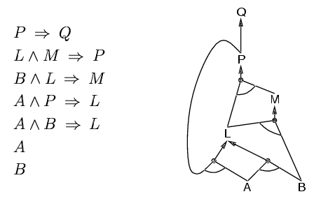
Forward chaining (Data driven reasoning)
Idea: fire any rule whose premises are satisfied in the KB,
add its conclusion to the KB, until query is found
AND-OR graph

Slide 43
Proof of completeness
FC derives every atomic sentence that is entailed by KB
FC reaches a fixed point where no new atomic sentences are derived
Consider the final state as a model m, assigning true/false to symbols
Every clause in the original KB is true in m
a₁ ∧ … ∧ a_{k ⇒} b
Hence m is a model of KB
If KB╞ q, q is true in every model of KB, including m

Slide 44
Backward chaining
Idea: work backwards from the query q:
to prove q by BC,
check if q is known already, or prove by BC all premises of some rule concluding q
Avoid loops: check if new subgoal is already on the goal stack
Avoid repeated work: check if new subgoal
has already been proved true, or
has already failed

Slide 45
Forward vs. backward chaining
FC is data-driven, automatic, unconscious processing,
e.g., object recognition, routine decisions
May do lots of work that is irrelevant to the goal
BC is goal-driven, appropriate for problem-solving,
e.g., Where are my keys? How do I get into a PhD program?
Complexity of BC can be much less than linear in size of KB in practice.

Slide 46
Propositional logic: pro and con
Advantages
Simple KR language sufficient for some problems
Lays the foundation for higher logics (e.g., FOL)
Reasoning is decidable, though NP complete, and efficient techniques exist for many problems
Disadvantages
Not expressive enough for most problems
Even when it is, it can very “un-concise”

Slide 47
PL is a weak KR language
Hard to identify “individuals” (e.g., Mary, 3)
Can’t directly talk about properties of individuals or relations between individuals (e.g., “Bill is tall”)
Generalizations, patterns, regularities can’t easily be represented (e.g., “all triangles have 3 sides”)
First-Order Logic (FOL) is expressive enough to represent this kind of information using relations, variables and quantifiers, e.g.,
Every elephant is gray: ∀ x (elephant(x) → gray(x))
There is a white alligator: ∃ x (alligator(X) ^ white(X))

Slide 48
First Order Logic

Slide 49
First Order Logic
Propositional Logic about atomic facts
Propositional logic has no objects.
Because it has no objects it also has no relationships between objects, or functions that names objects
FOL- Stronger ontological commitment
Objects (with individual identities)
Objects have properties
Relations between objects
FOL is very well understood

Slide 50
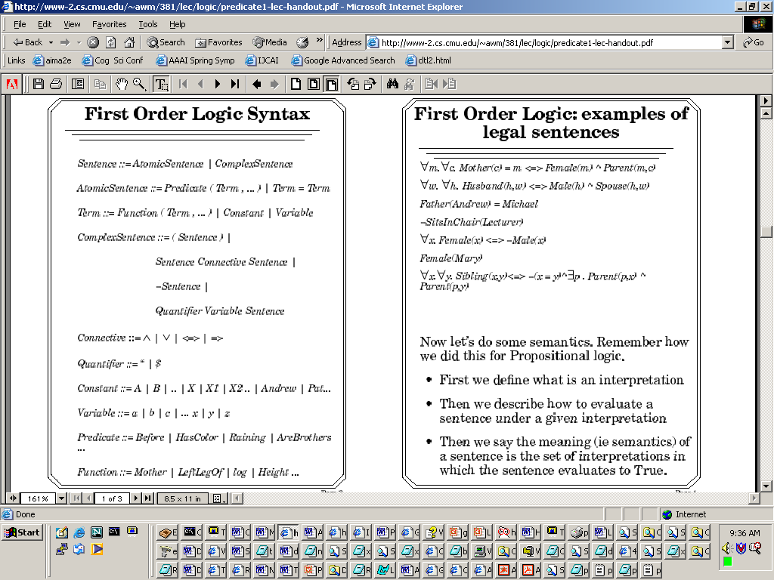
First Order Logic Syntax
ForAll | ThereExists

Slide 51
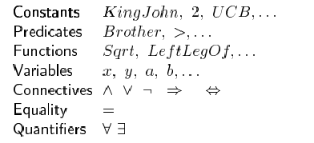
Syntax of FOL

Slide 52
First order logic
SENTENCES that represent Boolean facts
TERMS which represent objects
CONSTANTS and VARIABLES which represent objects
PREDICATE which given an object (I.e. TERM) it returns true or false
FUNCTIONS which given an object will return another object

Slide 53
Details
Informally: Objects like ColinPowell, Mars, Austrailia
Variables: general use lower case letters
Constants: Use uppercase, or starting with uppercase
Formally Speaking a predicate is a set of tuples
BrotherHoodPredicate={<KingJohn, RichardTheLionHeart> < RichardTheLionHeart, KingJohn> }

Slide 54
Atomic Sentence
Brother(Richard,John)
Married(FatherOf(Richard),MotherOf(John))
An atomic sentence is true iff the relation referred to by the predicate holds between the objects referred to by the arguments

Slide 55
Complex Sentences
And, OR, Implies and Not
Mother(Anne,Neil) ^ Mother(Anne,Eileen)
AtWar(USA) v AtPeace(USA)
Mother(Anne,Neil)➔Older(Anne,Neil)
¬Mother(Anne,GeorgeBush)

Slide 56
Quantifier
A predicate becomes a proposition when we assign it fixed values. However, another way to make a predicate into a proposition is to quantify it. That is, the predicate is true (or false) for all possible values in the universe of discourse or for some value(s) in the universe of discourse. Such quantification can be done with two quantifiers: the universal quantifier and the existential quantifier.

Slide 57
Universal Quantification
∀<variables> <sentence>
All students at WPI are smart.
∀s at(s,WPI)=> smart(s)
What does this mean?
∀s at(s,WPI) ^ smart(s)
All objects are at WPI and all objects are smart

Slide 58
The universal quantification of a predicate P(x) is the proposition “P(x) is true for all values of x in the universe of discourse” We use the notation
∀xP(x)
which can be read “for all x”
∀xP(x) ⇐⇒ P(n1) ∧ P(n2) ∧ · · · ∧ P(nk)

Slide 59
Example 1
Let P(x) be the predicate “x must take a discrete mathematics course” and let Q(x) be the predicate “x is a computer science student”.
The universe of discourse for both P(x) and Q(x) is all UNL students.
Express the statement “Every computer science student must take a discrete mathematics course”.
∀x(Q(x) → P(x))
Express the statement “Everybody must take a discrete mathematics course or be a computer science student”.

Slide 60
Example 2
Let P(x) be the predicate “x must take a discrete mathematics course” and let Q(x) be the predicate “x is a computer science student”.
The universe of discourse for both P(x) and Q(x) is all UNL students.
Express the statement “Every computer science student must take a discrete mathematics course”.
∀x(Q(x) → P(x))
Express the statement “Everybody must take a discrete mathematics course or be a computer science student”

Slide 61
Existential Quantification
∃ <variables> <sentence>
There exist a student at MIT that is smart
∃ s at(s,MIT) ^ smart(s)
What does this mean?
∃ s at(s,MIT) => smart(s)

Slide 62
The existential quantification of a predicate P(x) is the proposition “There exists an x in the universe of discourse such that P(x) is true.” We use the notation ∃xP(x) which can be read “there exists an x”
∃xP(x) ⇐⇒ P(n1) ∨ P(n2) ∨ · · · ∨ P(nk)

Slide 63
Let P(x, y) denote the statement, “x + y = 5”.
What does the expression, ∃x∃yP(x) mean?
What universe(s) of discourse make it true?
Express the statement “there exists a real solution to ax2 + bx − c = 0”

Slide 64
Express the statement “there exists a real solution to ax2 + bx − c = 0”
Let P(x) be the statement x = −b± √ b2−4ac 2a
where the universe of discourse for x is the set of reals.
Note here that a, b, c are all fixed constants.
The statement can thus be expressed as
∃xP(x)

Slide 65
Question: what is the truth value of ∃xP(x)?
It is false. For any real numbers such that b 2 < 4ac, there will only be complex solutions, for these cases no such real number x can satisfy the predicate.
How can we make it so that it is true?
Answer: change the universe of discourse to the complex numbers, C.

Slide 66
When are quantified statements true/false?
Statement | True When | False When
∀xP(x) | P(x) is true for every x. | There is an x for which P(x) is false.
∃xP(x) | There is an x for which P(x) is true. | P(x) is false for every x.

Slide 67
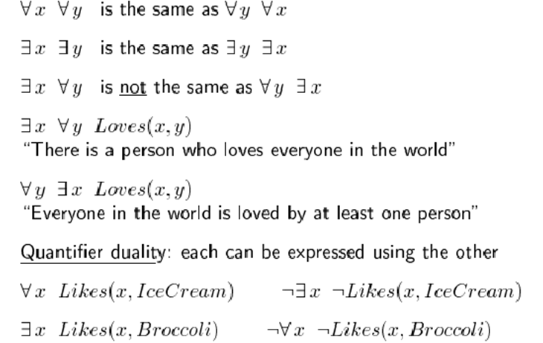
Properties of Quantifiers

Slide 68
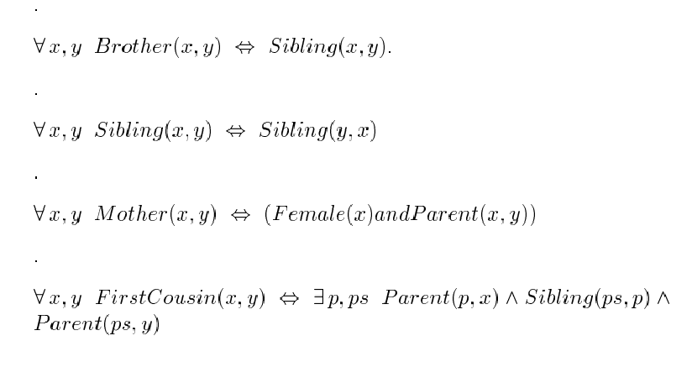

Slide 69
Existential and universal quantifiers can be used together to quantify a predicate statement; for example,
∀x∃yP(x, y)
is perfectly valid. However, you must be careful—it must be read left to right.
For example, ∀x∃yP(x, y) is not equivalent to ∃y∀xP(x, y). Thus, ordering is important.
Mixing Quantifiers I

Slide 70
Mixing Quantifiers II
For example: ∀x∃yLoves(x, y): everybody loves somebody
∃y∀xLoves(x, y): There is someone loved by everyone
Those expressions do not mean the same thing!
Note that ∃y∀xP(x, y) → ∀x∃yP(x, y), but the converse does not hold
However, you can commute similar quantifiers; ∃x∃yP(x, y) is equivalent to ∃y∃xP(x, y) (which is why our shorthand was valid).

Slide 71
Truth Values of 2-variate Quantifiers
Statement | True When | False When
∀x∀yP(x, y | P(x, y) is true for every pair x, y. | There is at least one pair, x, y for which P(x, y) is false.
∀x∃yP(x, y) | For every x, there is a y for which P(x, y) is true. | There is an x for which P(x, y) is false for every y.
∃x∀yP(x, y) | There is an x for which P(x, y) is true for every y. | For every x, there is a y for which P(x, y) is false.
∃x∃yP(x, y) | There is at least one pair x, y for which P(x, y) is true. | P(x, y) is false for every pair x, y.

Slide 72
Second Order Logic
In FOL, we quantify over individuals, but not over properties.
More Expressive
Cube(a) ∧ Cube(b)
∃P (P(a) ∧ P(b))
SameShape(a, b)
(Cube(a) ∧ Cube(b)) ∨ (Tet(a) ∧ Tet(b)) ∨ (Dodec(a) ∧ Doced(b))
Shape(Cube) ∧ Shape(Tet) ∧ Shape(Dodec)
∃P (Shape(P) ∧ P(a) ∧ P(b))

